Slide 1
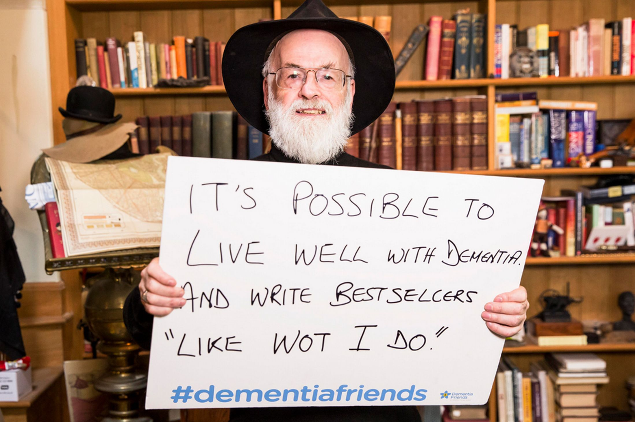
Dementia revisited
Who is this man?

Slide 2
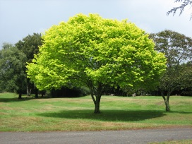







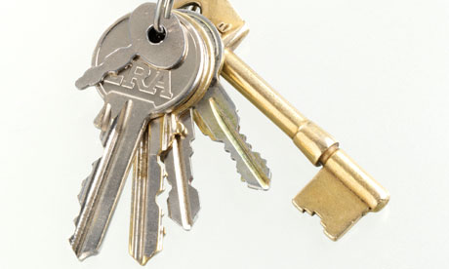
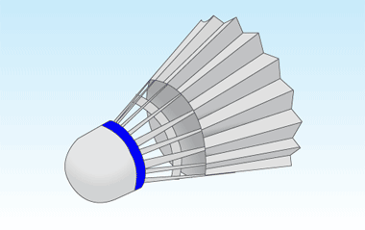



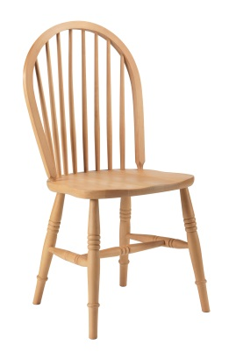

Kim’s game
You have two minutes to memorise this list of objects
There is a block of chocolate for anyone who gets it all right but no cheating!

Slide 3
Now you have to sit in silence for one minute trying to remember your list!

Slide 4






Kim’s game
Now mark your paper
How many did you get right?

Slide 5
Lesson objectives
To revisit the symptoms and ways of lessening chances of dementia
To think about the difference between normal memory loss and dementia
To consider the problems faced by those with dementia and how they can be helped
To remember the importance of keeping the brain active

Slide 6
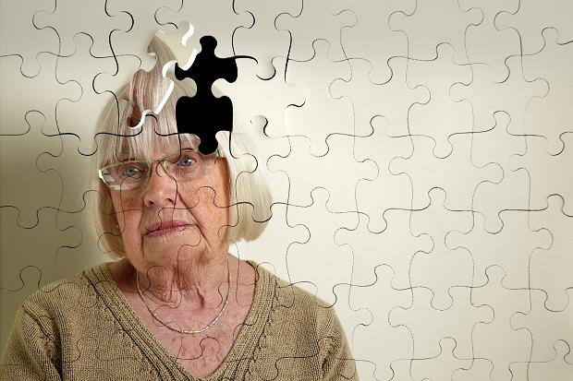
Task 1
Around your picture write down the answers to these questions
What are the symptoms of dementia?
What can you do to lessen your chance of getting dementia?

Slide 7

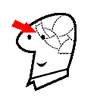
Symptoms
SPEAKING
MEMORY
MOVEMENT
COGNITION
EYESIGHT
HEARING

Slide 8
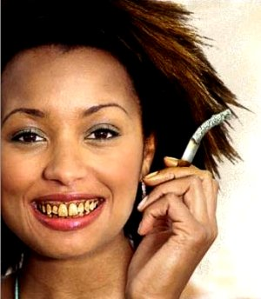
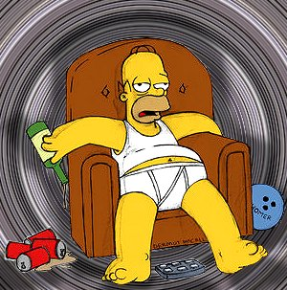

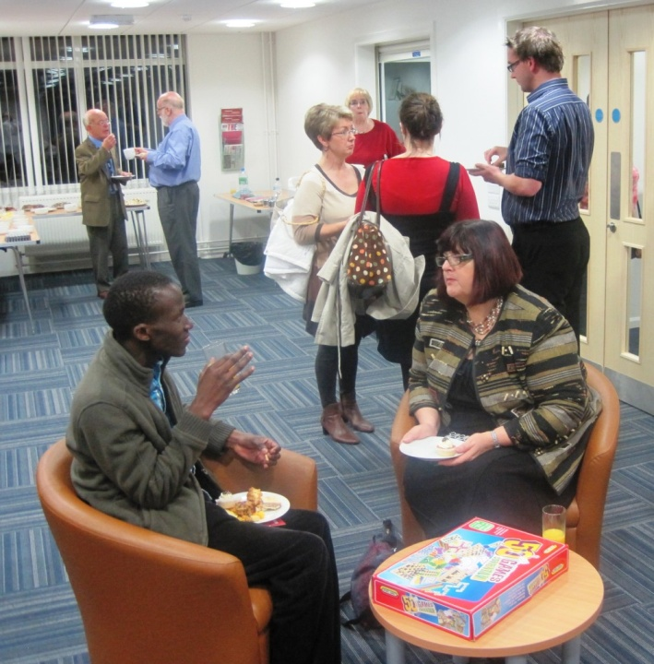
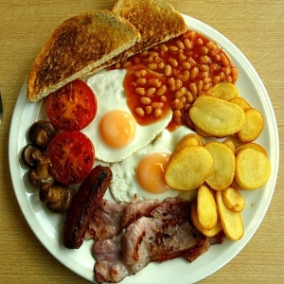

Prevention

Slide 9
In the year since you did the lessons:
225,000 people have developed dementia
Assuming that there are 10 relatives then that means 2,250,000 people have been affected by dementia.
And that means that there are at 800,000 people with dementia and…
8 million people affected by dementia

Slide 10

Task 2 - Normal memory loss or signs of dementia?
At the present time, there is no fast and true list of symptoms, or readily available test that can easily diagnose Alzheimer’s or Dementia. Many psychological and neurological tests must be done to eliminate any other medical condition for any suspect behaviour. This task is just an indication.
Look at Task 2. After each statement write NM for normal memory loss or D for signs of dementia

Slide 11
So what do you think?
1. They forget names or appointment.
2. They can’t remember why they came into a room.
3. They forget recently learned information.
4. They can’t remember the right word for an everyday object.
5. They can’t remember how to use a phone or play a game.
6. They use the wrong word to describe something.
7. They forget what day of the week it is.
8. They put clothes that don’t go together.
9. They put on unsuitable clothes.
10. They feel sad or moody
11. They keep losing things
12. They seem less interested in their personal hygiene

Slide 12
Feedback
There are no hard and fast answers for these. Some are more worrying than others although we probably all don’t most of them. 3,5,6,9 and 12 are the more worrying.
If it’s occasional it’s not a problem. If it is more frequent then it might need to be checked out.

Slide 13
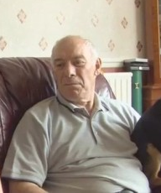
Task 3 – Helping a person with dementia
This is Jim from last year. Look at your list of problems and for each one give practical suggestions that might help.

Slide 14
Suggestions
Bathing and personal hygiene
Dressing
Toileting and incontinence
Cooking
Eating
Driving
Alcohol and cigarettes
Sleeping
Theft (by them or from them)
Wandering

Slide 15
And finally - Task 4 - Odd one out
I am going to give you 1 minute to look at the following pictures and then ask you to say which is the odd one odd?

Slide 16

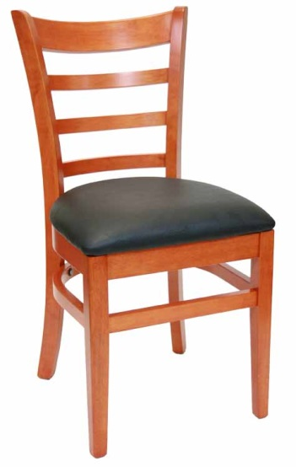
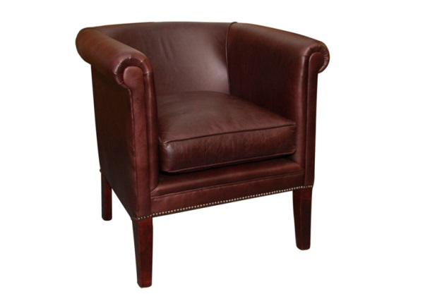
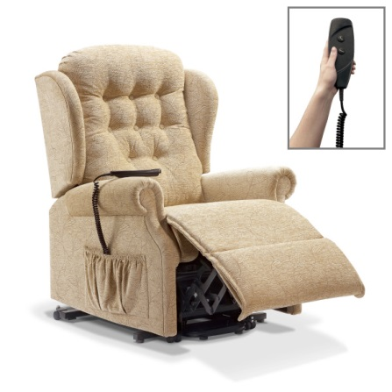
Chairs

Slide 17




Flowers

Slide 18




Cats

Slide 19




Fruit

Slide 20
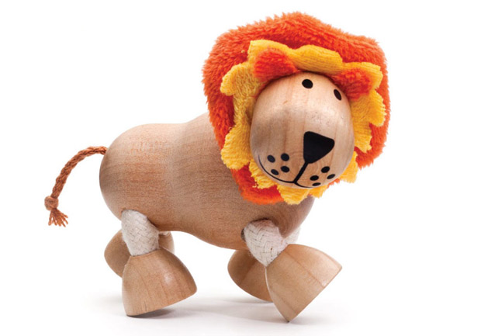
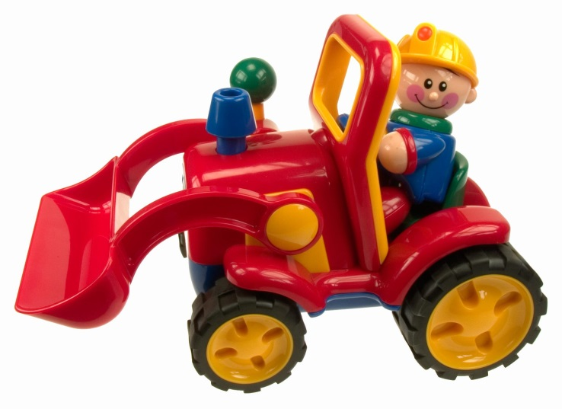

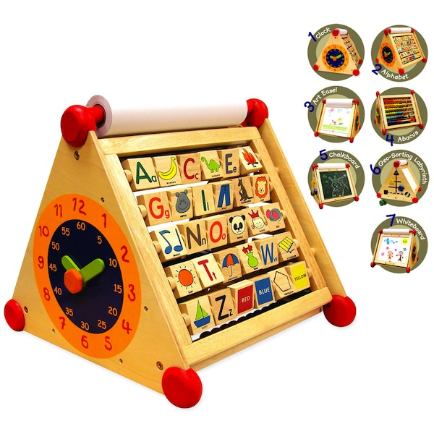
Toys

Slide 21
And finally, finally… Task 5 - Order
Write down the correct order of objects I’ve just given you

Slide 22
Did you get it right?
Chair
Flowers
Cats
Fruit
Toys

Slide 23
And finally, finally, finally … Task 6
What was the object I added in Kim’s game?

Slide 24
Plenary
Write down something you already knew
Write down something you’ve learnt
Write down something that made you smile

